Slide 1


Correctness-Preserving compression of datasets AND Neural Network Models
Vinu Joseph, Nithin Chalapathi, Aditya Bhaskara,
Ganesh Gopalakrishnan, Pavel Panchekha and Mu Zhang
Correctness 2020: Fourth International Workshop on
Software Correctness for HPC Applications

Slide 2
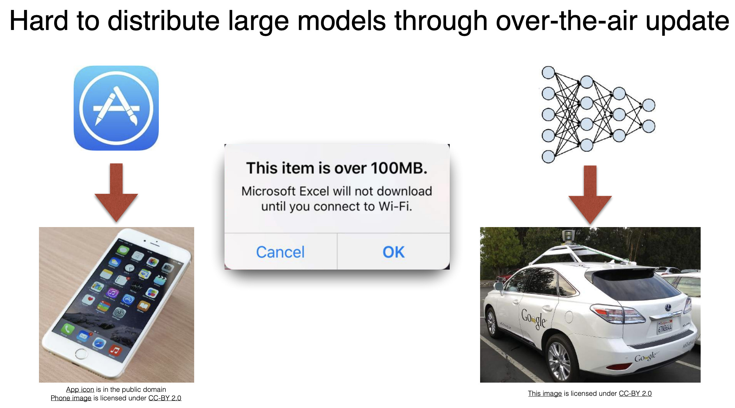
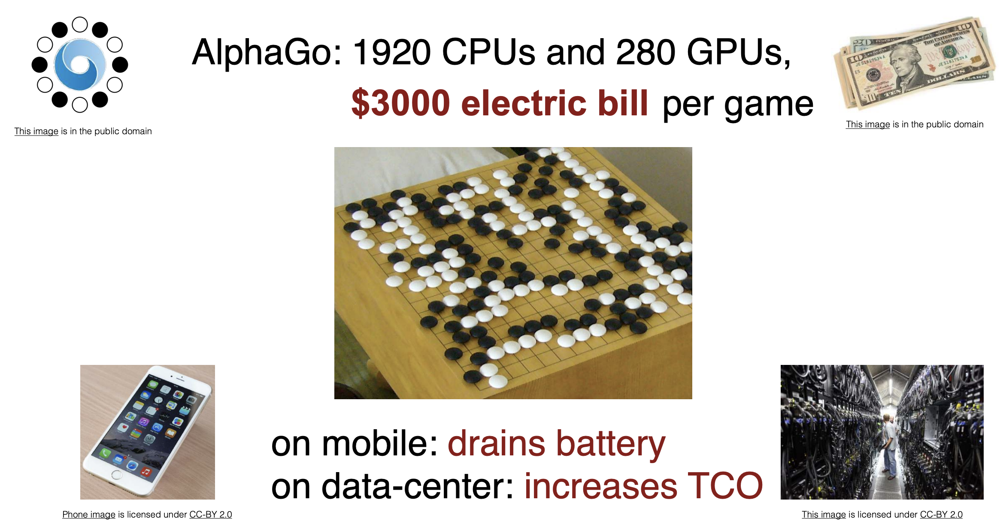
REAL-WORLD CONSTRAINTS during inference
Congnitive Ability
Memory Constraint
Compute/Energy Constraint

Slide 3
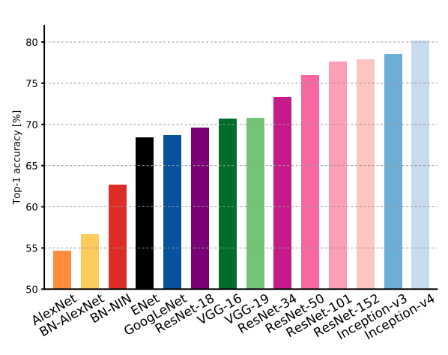
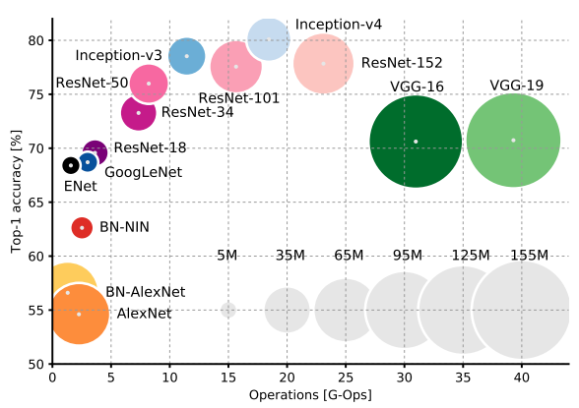
Performance ramifications of DNNs
Better
Memory Constraint
Congnitive Ability +
Compute/Energy Constraint

Slide 4
MODEL COMPRESSION - Overview of Condensa METHODS FOR CORRECTNESS - The Four Levels of Abstractions DATASET COMPRESSION - Condensa Extensions - Applying the Correctness Methods
Agenda

Slide 5
MODEL COMPRESSION
What is it?
Process of obtaining a “smaller” model on same task with the same accuracy
Why compress?
Proven to improve memory and runtime efficiency of DNN models
Why does compression work?
Modern DNNs are significantly over-provisioned (number and representation of weights)
How to compress?
Many strategies, including weight pruning, quantization, and low-rank factorization

Slide 6
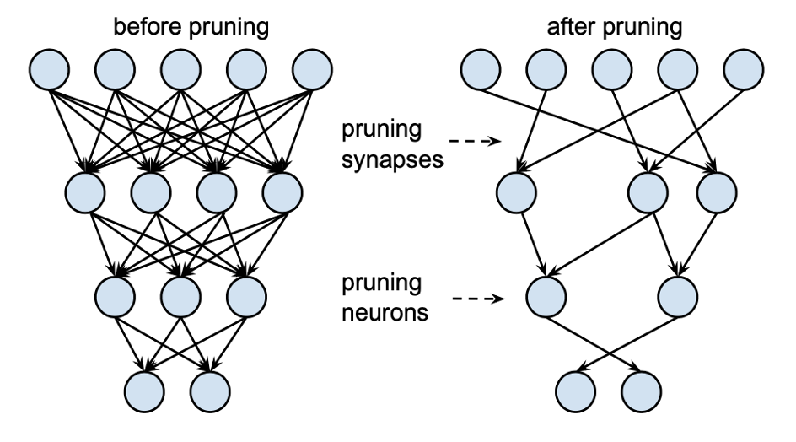
WEIGHT PRUNING
What is pruning?
Removal of low-magnitude weights
Types
Pruning may be unstructured (individual non-zero weights) or structured (blocks of non-zero weights)
How does it help?
Reduce memory footprint (unstructured) or improve hardware runtime (structured)
Sparsity
Proportion of zeroes to non-zeroes in compressed model

Slide 7
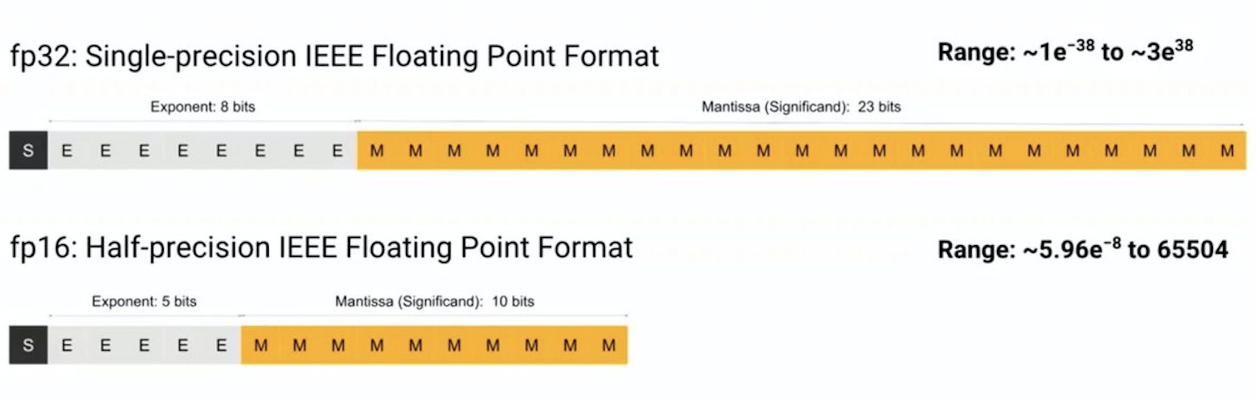
WEIGHT QUANTIZATION
What is quantization?
Using fewer bits to represent each weight
How does it help?
Reduces memory footprint and improves runtime (with hardware support) Eg: Tensor Cores on NVIDIA Volta GPUs

Slide 8
Why we built a programming system FOR MODEL COMPRESSION ?
Shortcoming 1: Difficult to express compression schemes customized for user’s goals and system and model constraints
Optimization Objective
Target Hardware
Input DNN
Shortcoming 2: Automatically finding compression hyperparameters such as sparsity
Manual Trial-and-Error
Sample Efficiency

Slide 9
CONDENSA SYSTEM DESIGN

Slide 10
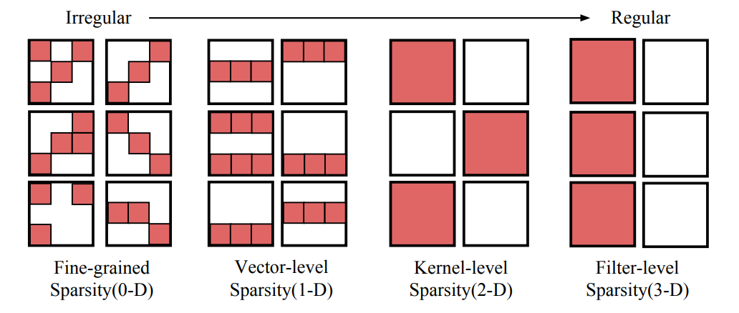
CONDENSA COMPRESSION SCHEMES
Scheme | Description
Quantize(dtype) | Quantizes network weights to given datatype dtype.
Prune() | Performs unstructured pruning of network weights.
NeuronPrune(criteria) | Aggregates and prunes neurons (1D blocks) according to criteria.
FilterPrune(criteria) | Aggregates and prunes filters (3D blocks) according to criteria.
StructurePrune(criteria) | Combines neuron and filter pruning.
BlockPrune(criteria, bs) | Aggregates and prunes n-D blocks of size bs according to criteria.
Compose(slist) | Composes together all schemes in slist.

Slide 11
Step 1: Define Scheme
scheme = Compose(Prune(), Quantize(condensa.float16))
Step 2: Specify Accuracy Threshold (ϵ), Define Objective Function
def memory_footprint(w):
return parameters_to_vector(w.parameters()).view(-1).nonzero().numel()
Step 3: Run Condensa, Obtain Compressed Network
Dataset | Network | Memory Footprint | Accuracy Drop (ϵ=2%)
CIFAR-10 | VGG-19 BN | 188.23x | +0.28%
CIFAR-10 | ResNet56 | 31.14x | -1.33%
ImageNet | VGG-16 BN | 29.29x | -1.61%
WikiText-2 | LSTM (2 layer) | 4.2x | -5.6 Perplexity

Slide 12


Slide 13
CONDENSA
Condensa is a novel framework for programmable model compression
Express compression strategies programmatically using the full power of Python
Use the Condensa Library to compose practical and interesting compression schemes
Automatically optimize compression for a user-defined objective such as throughput or latency
Obtaining Condensa
Code: https://github.com/NVlabs/condensa
Documentation: https://nvlabs.github.io/condensa
IEEE Micro: https://ieeexplore.ieee.org/document/9151283
Extended Version: https://arxiv.org/abs/1911.02497

Slide 14
Condensa: Performance Ramifications
What are the Correctness Ramifications of Compression ?

Slide 15
MODEL COMPRESSION - Overview of Condensa METHODS FOR CORRECTNESS - The Four Levels of Abstractions DATASET COMPRESSION - Condensa Extensions - Applying the Correctness Methods
Agenda

Slide 16
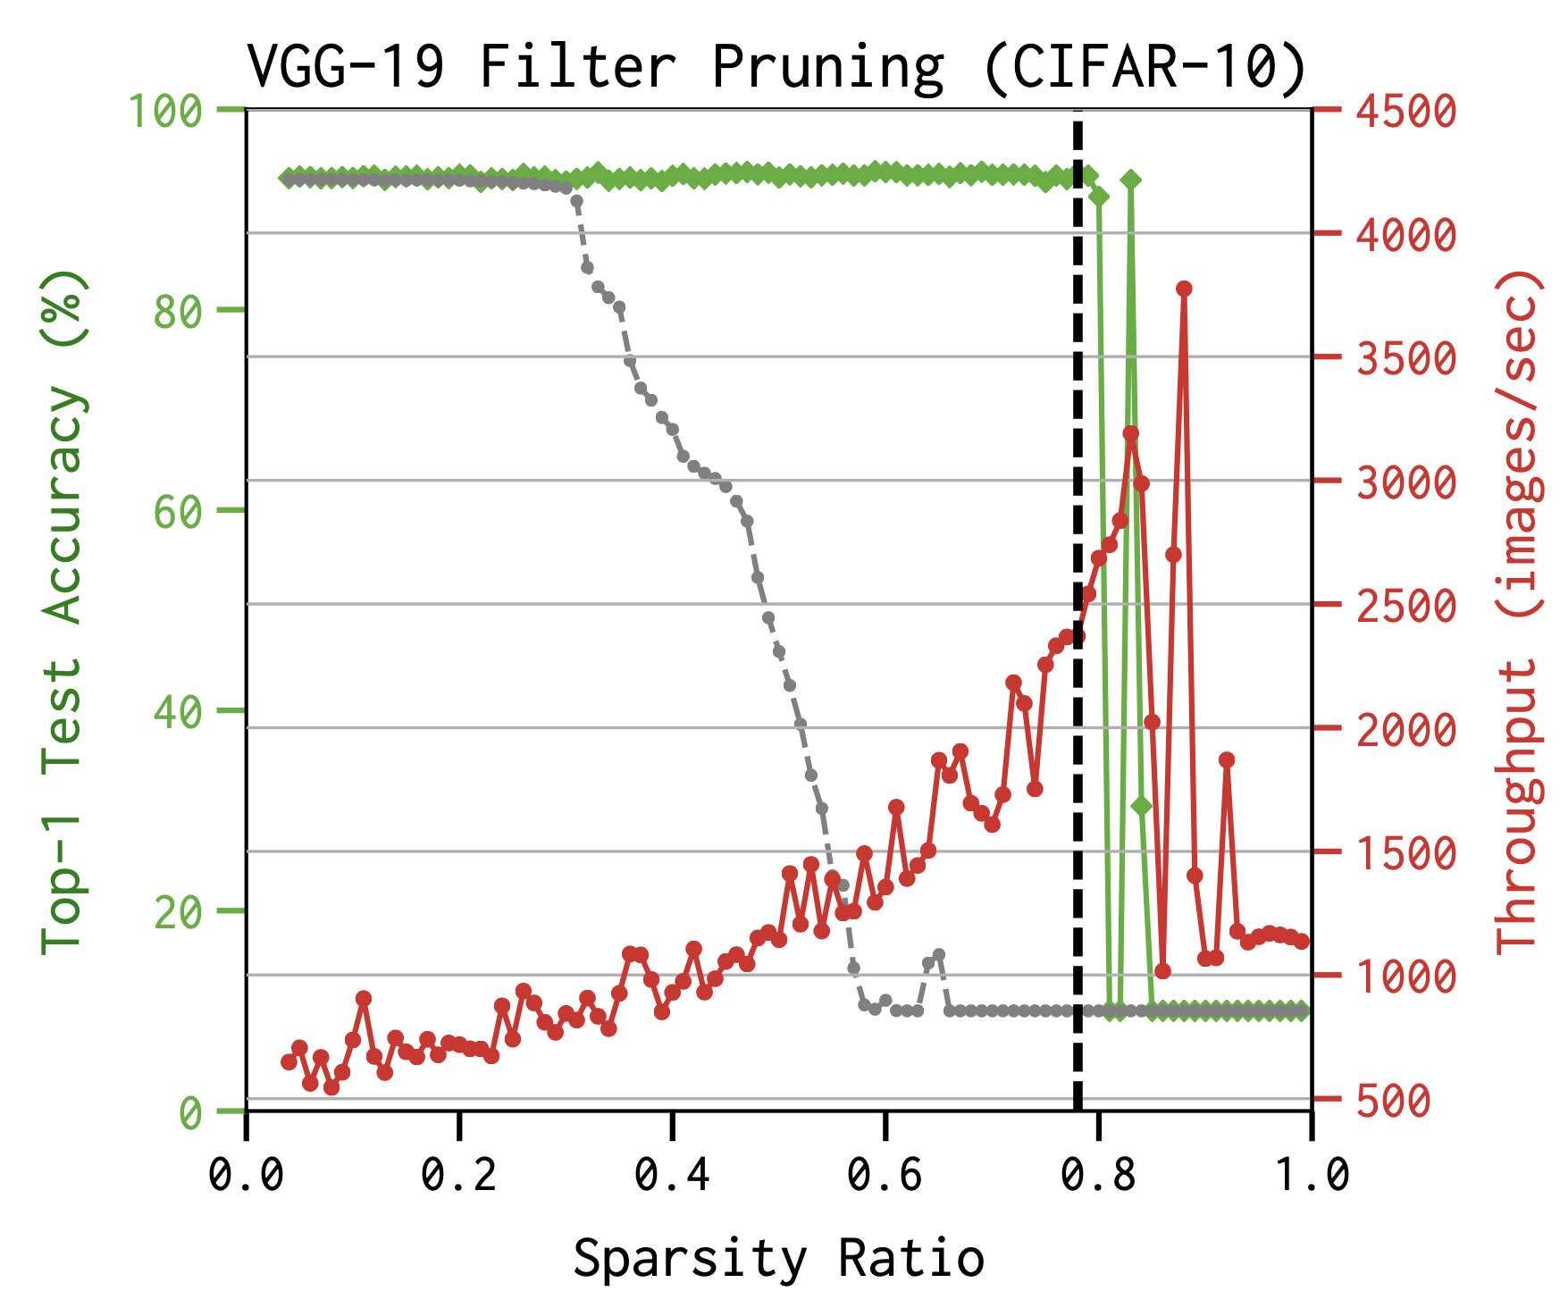
WHAT IS THE CORRECTNESS PROBLEM ?
VGG-19BN (CIFAR-10)
MODEL 1
MODEL 2
MODEL 3

Slide 17
WHAT IS THE CORRECTNESS PROBLEM ?
Effect of accuracy distribution across examples and classes
The ability to prune networks with seemingly so little degradation to generalization performance is puzzling!
The cost to top-1 accuracy appears minimal, but
Is it is now spread uniformly across all classes ?
What if the cost is concentrated in only a few classes?
Are certain types of examples or classes disproportionately impacted by pruning?

Slide 18
What do these Impacted Images Look like ?

Slide 19
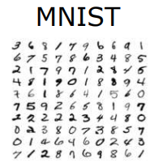
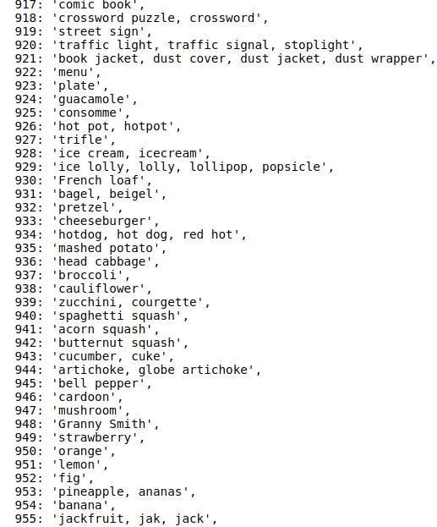
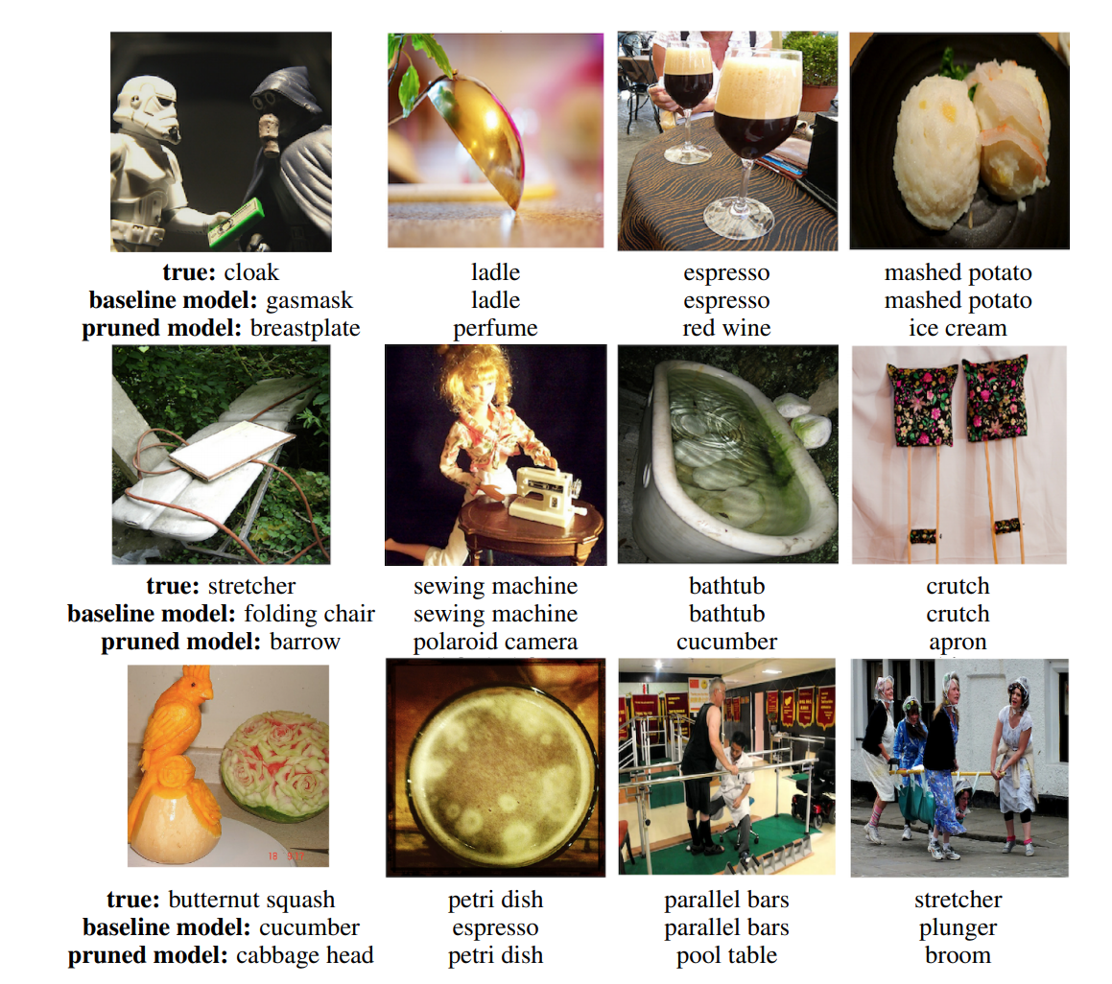
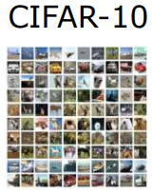
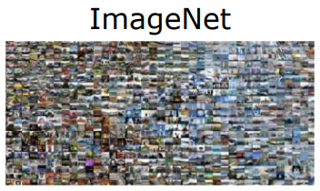
1
2
Notes:
https://gist.githubusercontent.com/yrevar/942d3a0ac09ec9e5eb3a/raw/238f720ff059c1f82f368259d1ca4ffa5dd8f9f5/imagenet1000_clsidx_to_labels.txt

Slide 20
WHY CORRECTNESS IN COMPRESSION ?
Mistakes are Expensive
An Understanding of Correctness is critical for sensitive tasks:
Tasks where the introduction of pruning may be at odds with fairness objectives to treat protected attributes uniformly and/or the need to guarantee a certain level of accuracy for certain classes.
Hiring, Health care diagnostics, Self-driving cars
Pruning is already commonly used in these domains, often driven by the resource constraints of deploying models to mobile phone or embedded devices.
Provide important insights about when pruned models are qualified to make decisions on real world inputs.

Slide 21
Correctness-Preservation A good starting Point

Slide 22
The Four Levels of Abstractions L1 : Neighborhoods in Input Space L2 : Cross Layer Comparisons L3 : Feature Space Embedding L4 : Output or Functional Level
Methods for Correctness

Slide 23
CONDENSA EXTENSIONS FOR CORRECTNESS : A MIND MAP

Slide 24
The Four Levels of Abstractions L1 : Neighborhoods in Input Space L2 : Cross Layer Comparisons L3 : Feature Space Embedding L4 : Output or Functional Level
Methods for Correctness

Slide 25
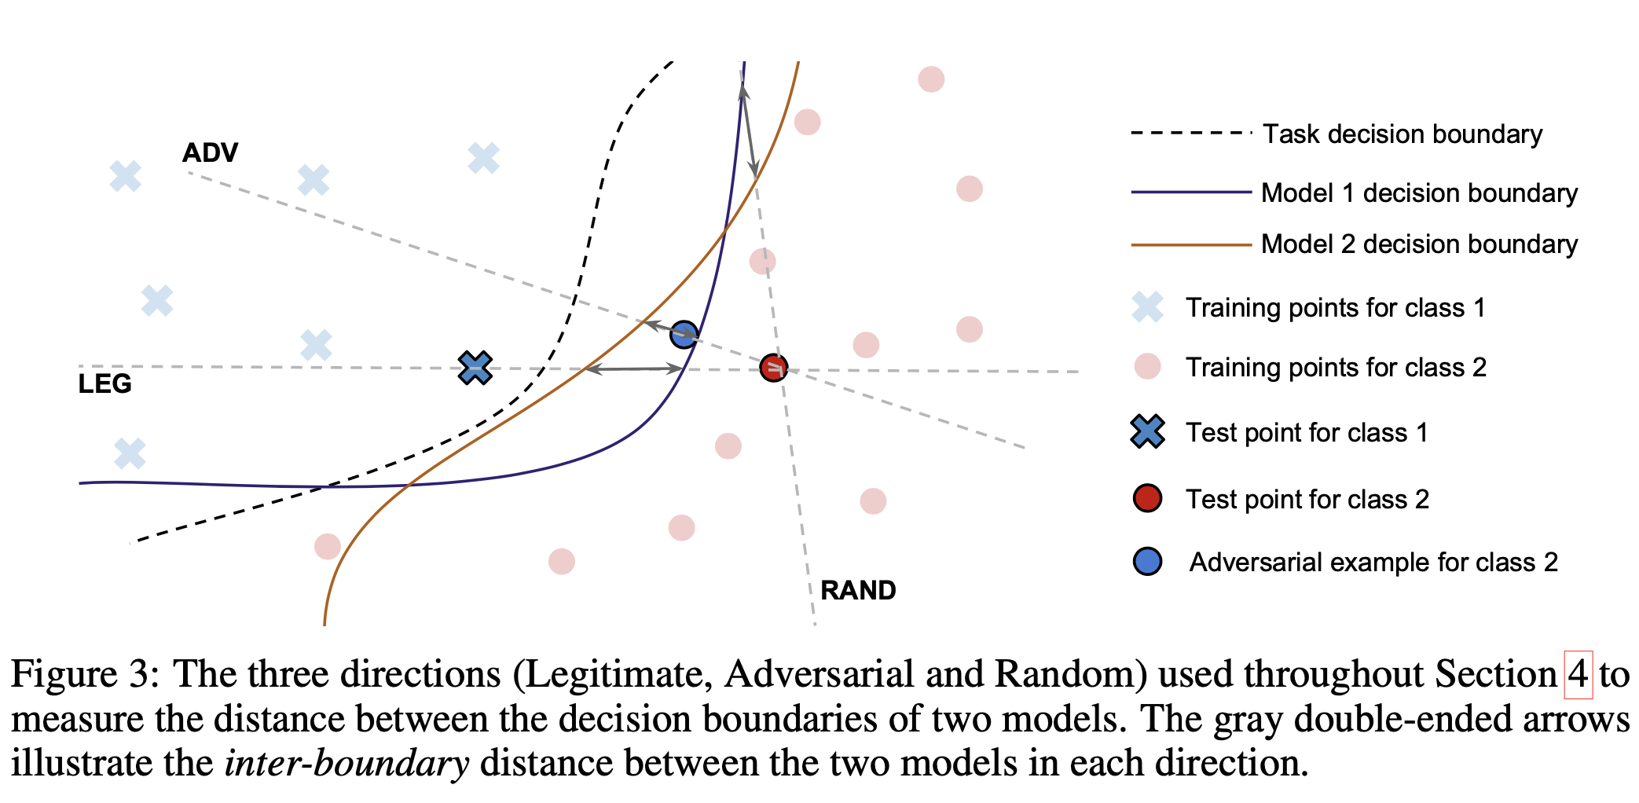
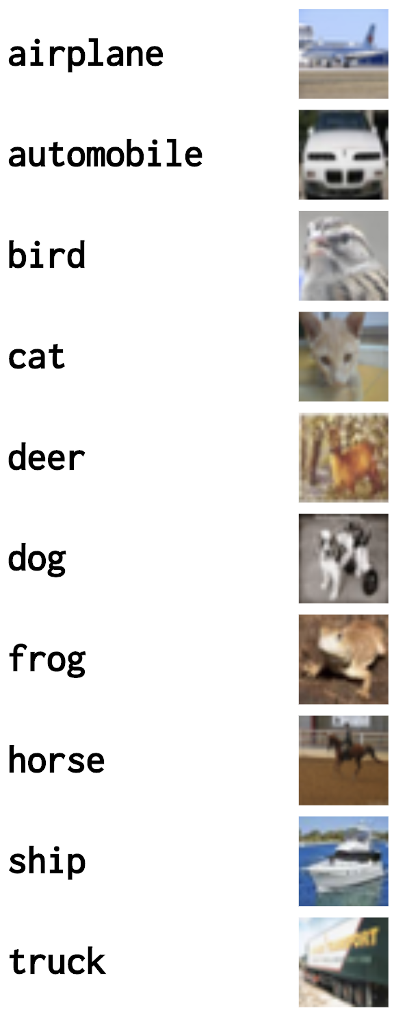
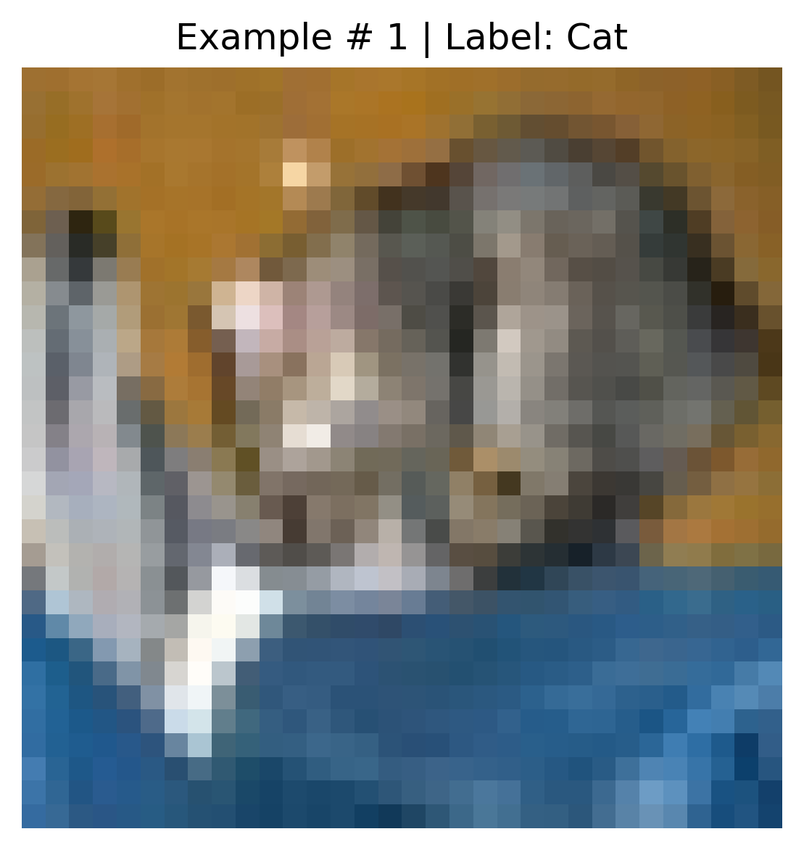
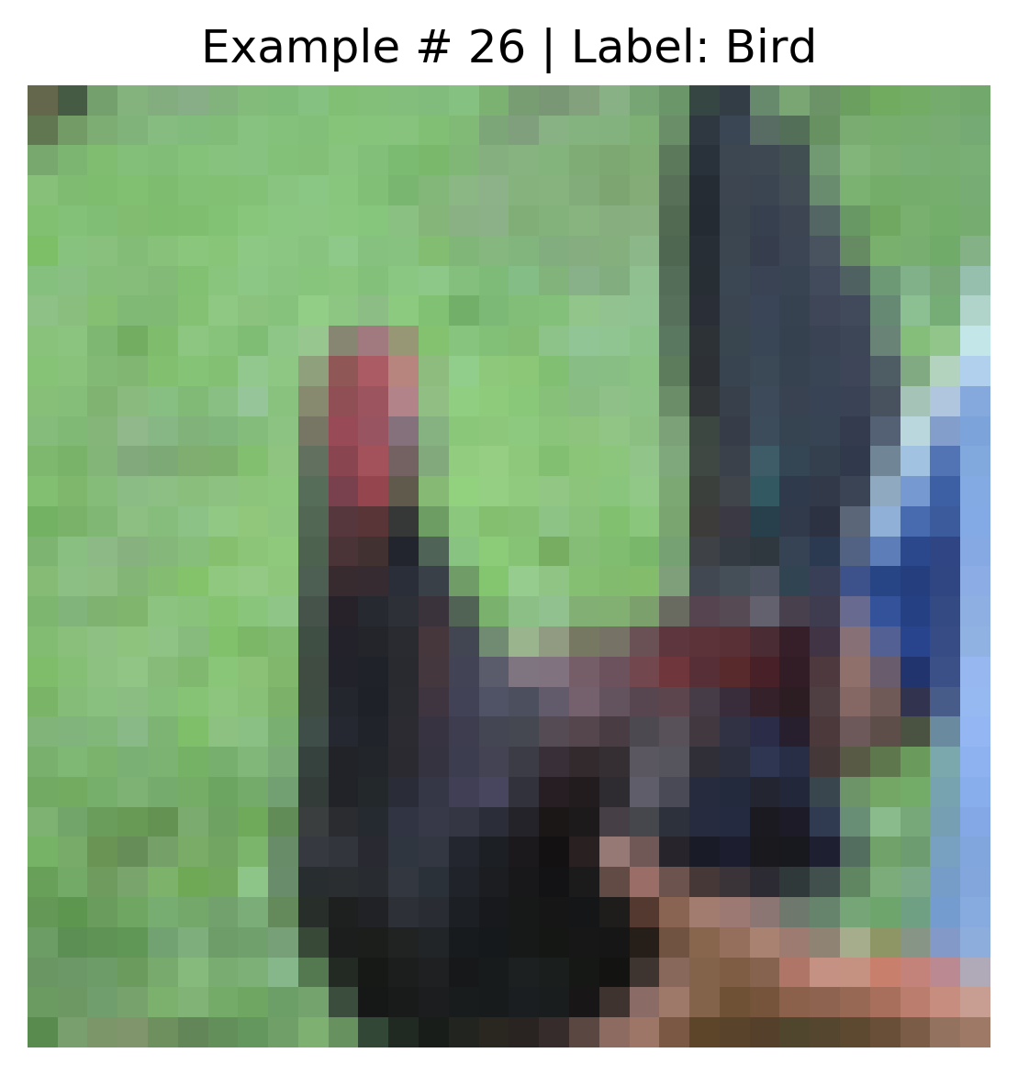
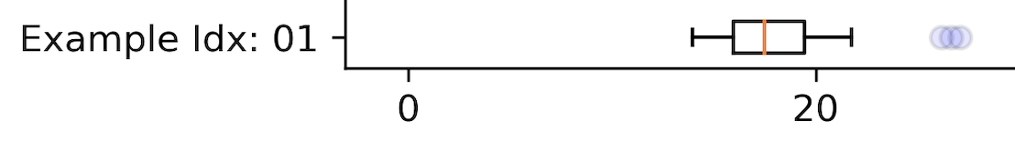
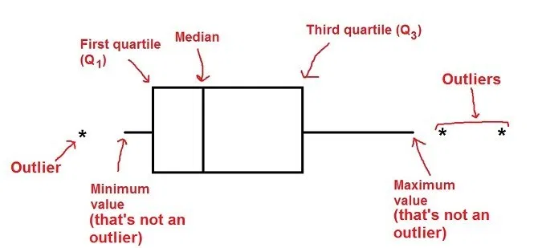
Using Random directions
How far are points from Decision boundaries really ?
Notes:
Evaluating the decision boundary of an ML model in high-dimensions is usually intractable. We thus restrict ourselves to measuring similarity in three linear directions, which are representative of the model behavior on and off the data manifold.

Slide 26


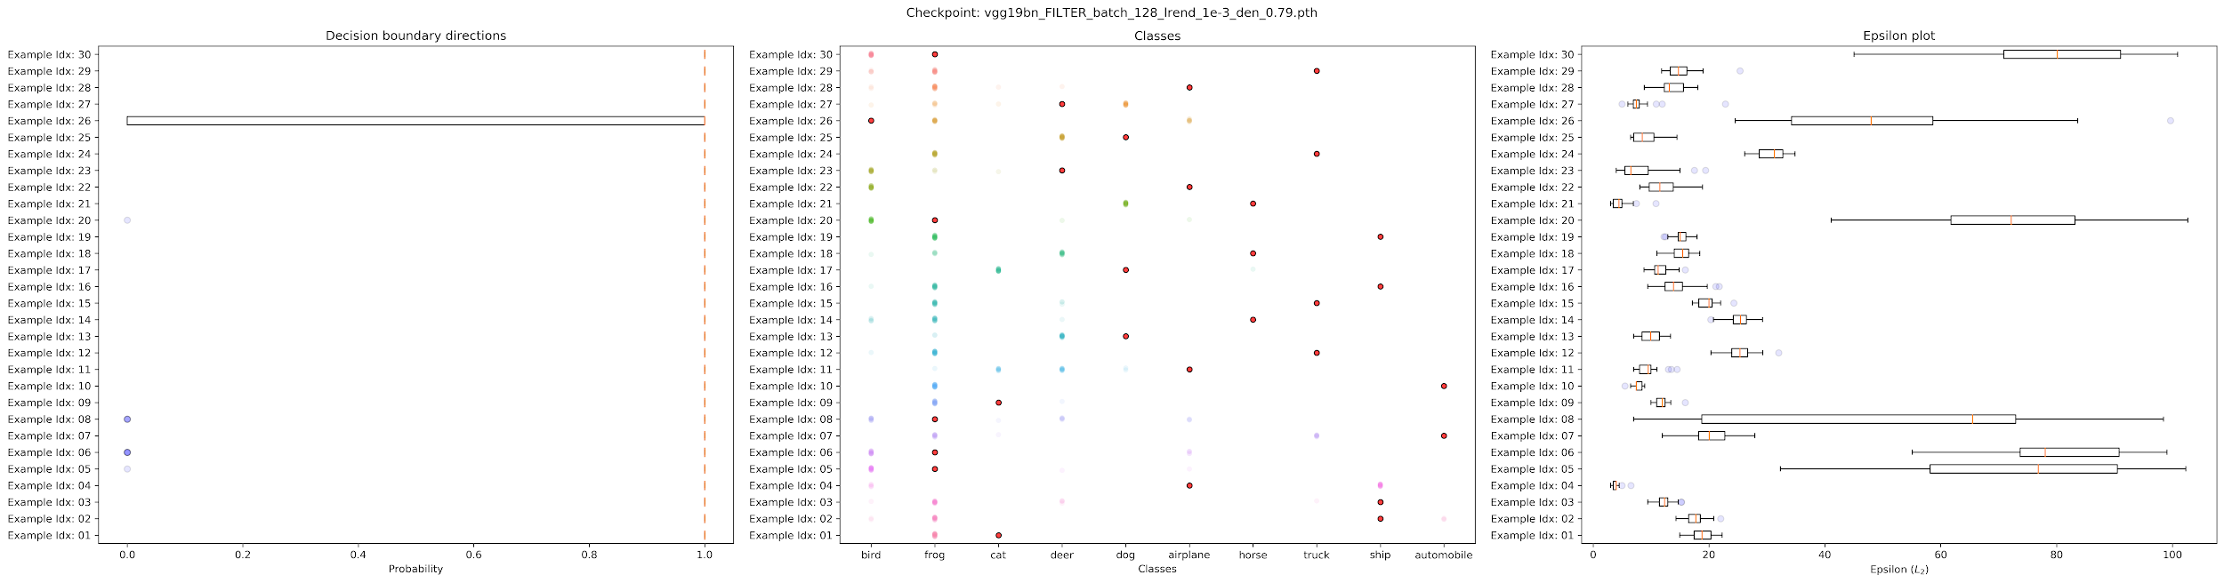
Decision Boundary Characterization
Model 2

Slide 27
The Four Levels of Abstractions L1 : Neighborhoods in Input Space L2 : Cross Layer Comparisons L3 : Feature Space Embedding L4 : Output or Functional Level
Methods for Correctness

Slide 28
The Four Levels of Abstractions L1 : Neighborhoods in Input Space L2 : Cross Layer Comparisons L3 : Feature Space Embedding L4 : Output or Functional Level
Methods for Correctness

Slide 29
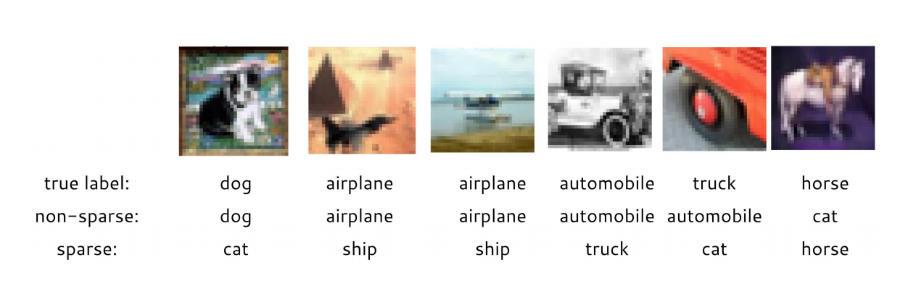
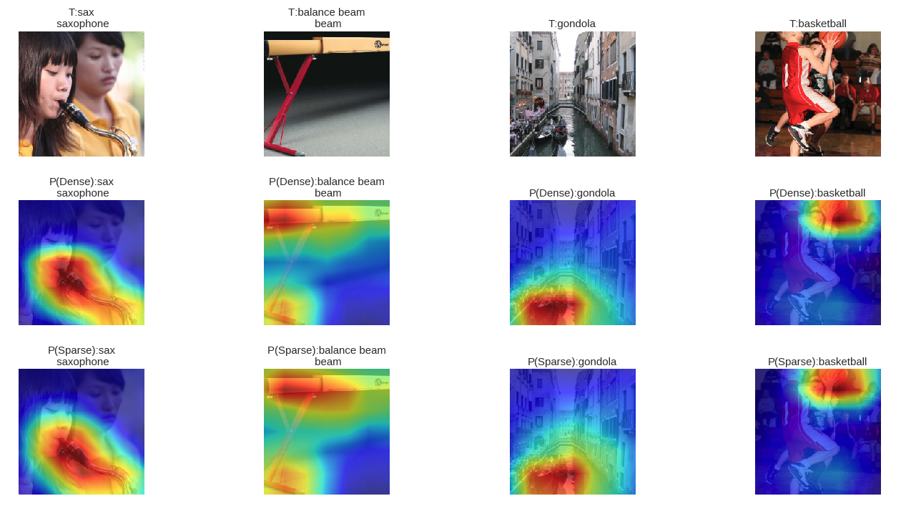

Slide 30
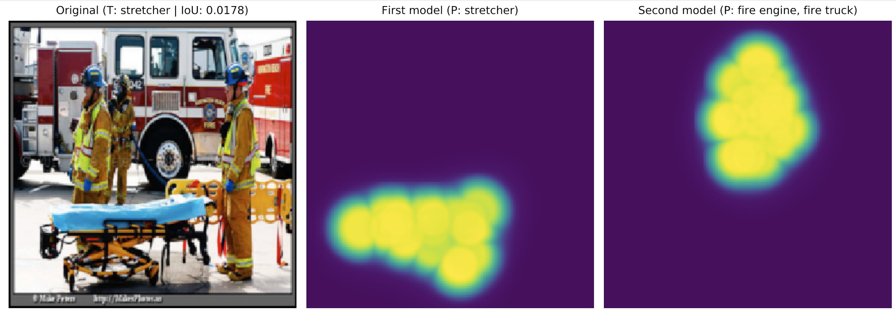
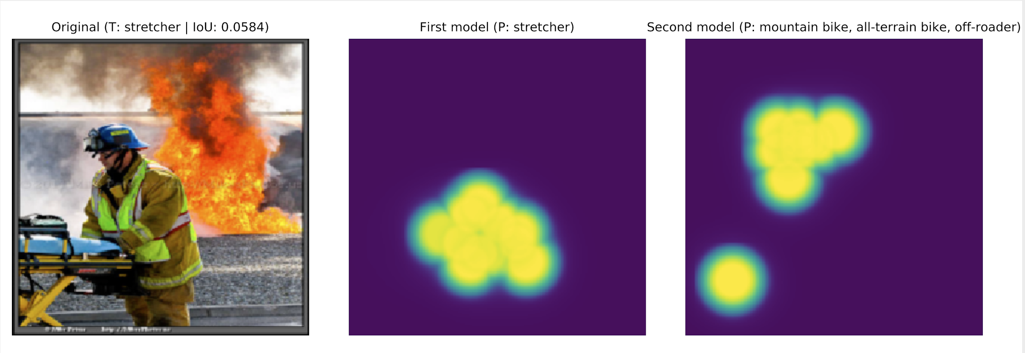

Slide 31
The Four Levels of Abstractions L1 : Neighborhoods in Input Space L2 : Cross Layer Comparisons L3 : Feature Space Embedding L4 : Output or Functional Level
Methods for Correctness

Slide 32
The Four Levels of Abstractions L1 : Neighborhoods in Input Space L2 : Cross Layer Comparisons L3 : Feature Space Embedding L4 : Output or Functional Level
Methods for Correctness

Slide 33
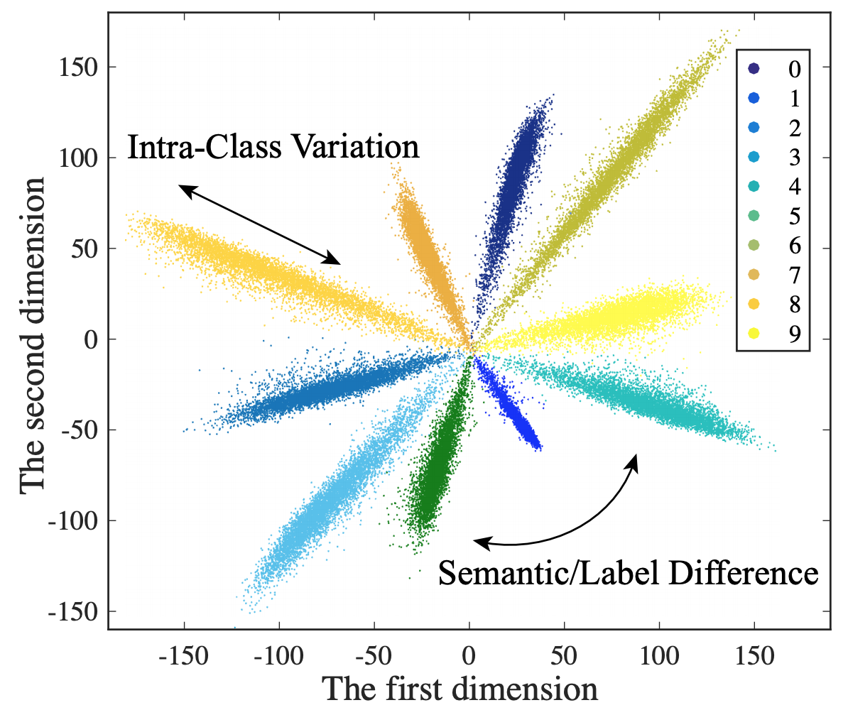
L3 : FEATURE SPACE EMBEDDING
Deeply learned features are naturally decoupled with angle and norm.
The angles reflect the semantic difference.

Slide 34
The Four Levels of Abstractions L1 : Neighborhoods in Input Space L2 : Cross Layer Comparisons L3 : Feature Space Embedding L4 : Output or Functional Level
Methods for Correctness

Slide 35
The Four Levels of Abstractions L1 : Neighborhoods in Input Space L2 : Cross Layer Comparisons L3 : Feature Space Embedding L4 : Output or Functional Level
Methods for Correctness

Slide 36
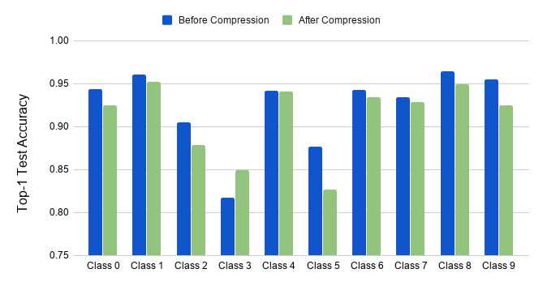
L4. Output or Functional Level
1
2
Output or Functional Level Analysis

Slide 37
L4. Output or Functional Level
Supervised learning problems often have semantic structure in the labels.
Benchmarks for evaluating image classification, have a hierarchical organization of labels, e.g., the categories ‘hamster’ and ‘mouse’ belong to the super-category ‘small mammals’.
In many real world applications, misclassification within the same super-category is more acceptable than across super-categories.

Slide 38
The Four Levels of Abstractions L1 : Neighborhoods in Input Space L2 : Cross Layer Comparisons L3 : Feature Space Embedding L4 : Output or Functional Level
Methods for Correctness

Slide 39
MODEL COMPRESSION - Overview of Condensa METHODS FOR CORRECTNESS - The Four Levels of Abstractions DATASET COMPRESSION - Condensa Extensions - Applying the Correctness Methods
Agenda

Slide 40
CONDENSA : TRIFECTA OF MODEL COMPRESSION

Slide 41
CONDENSA EXTENSIONS FOR DATASET COMPRESSION

Slide 42
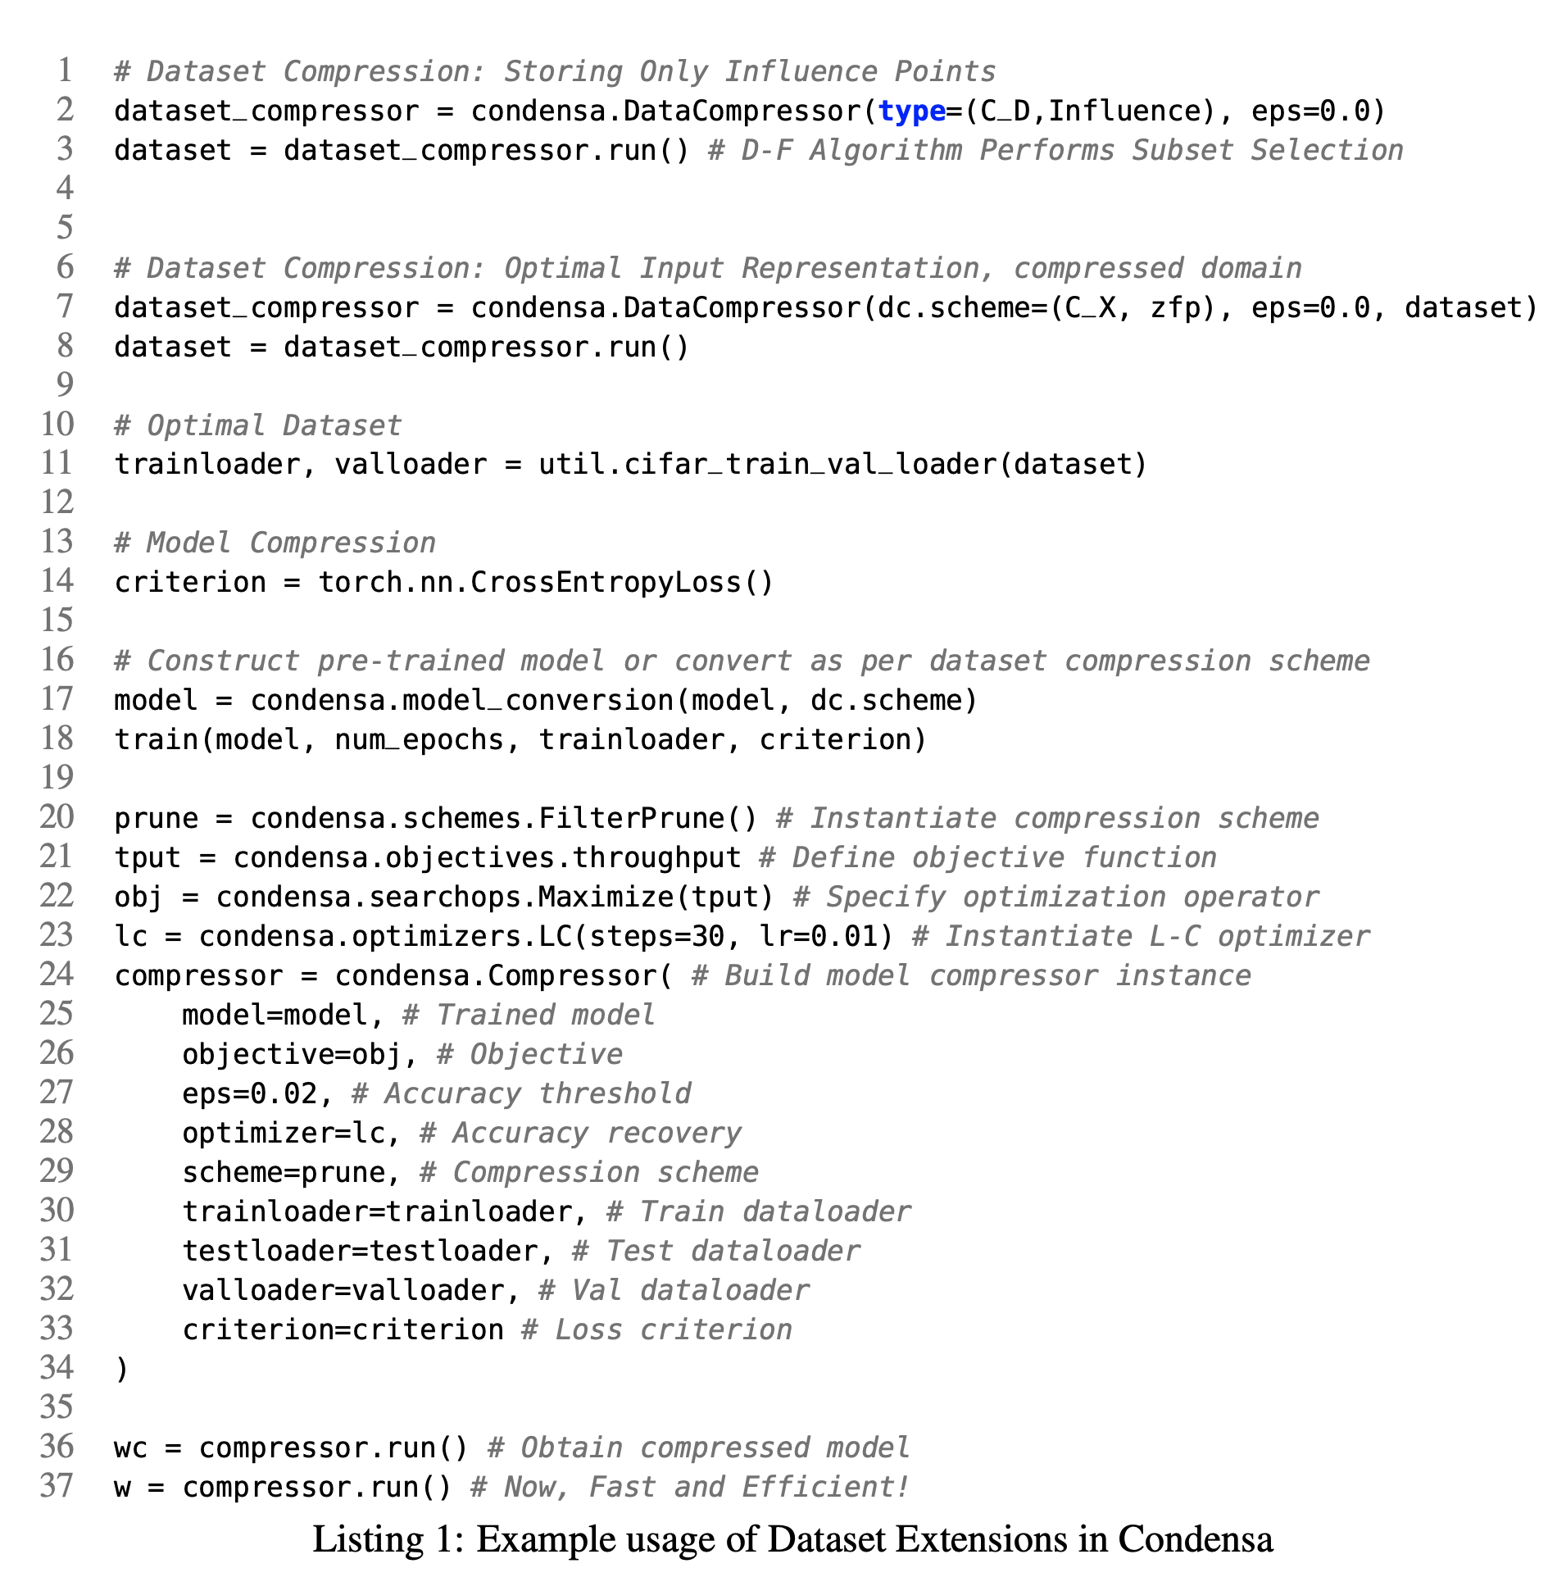
AXES OF DATASET COMPRESSION

Slide 43
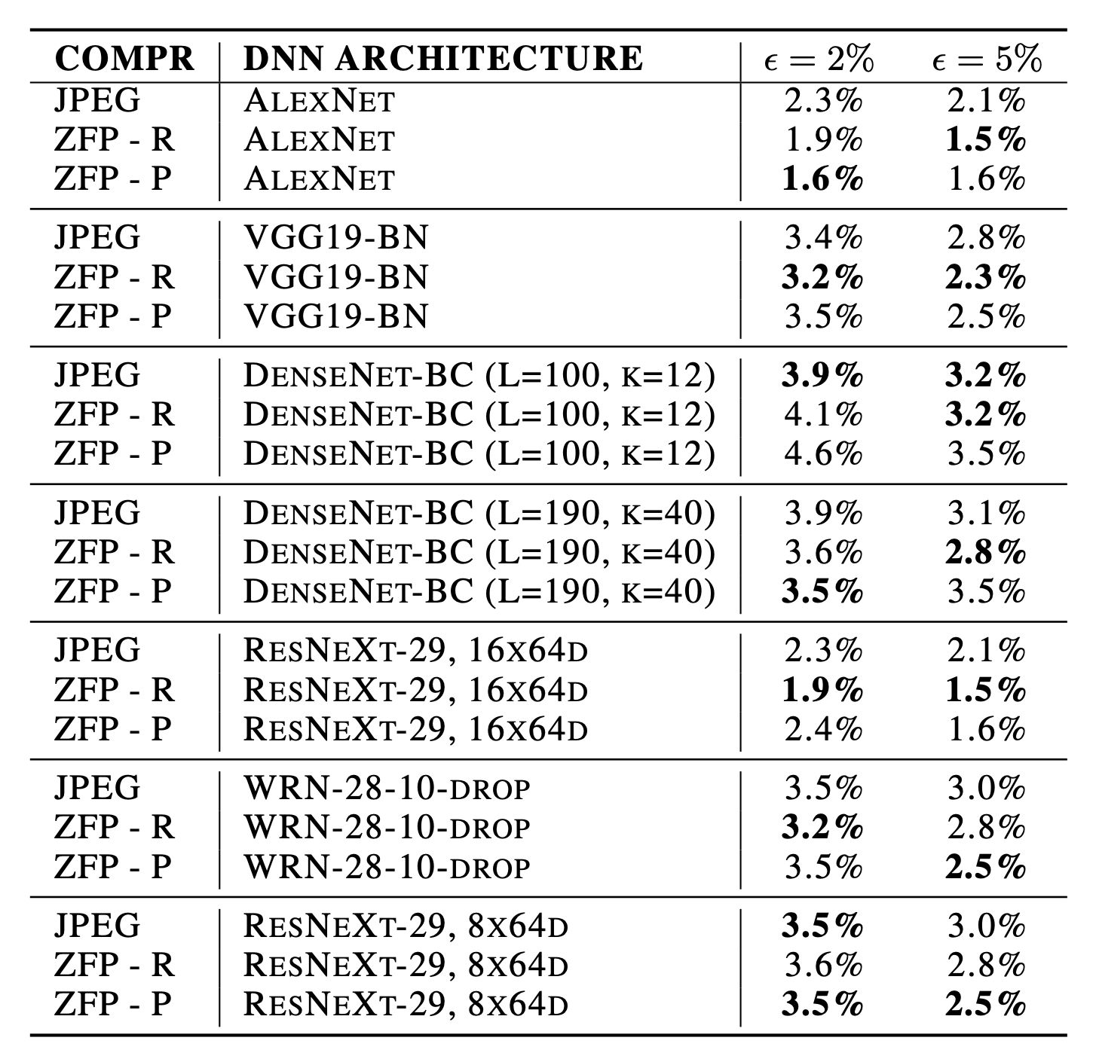
DATASET COMPRESSION : PERFORMANCE RAMIFICATIONS
What are the Correctness Ramifications of Compression ?

Slide 44
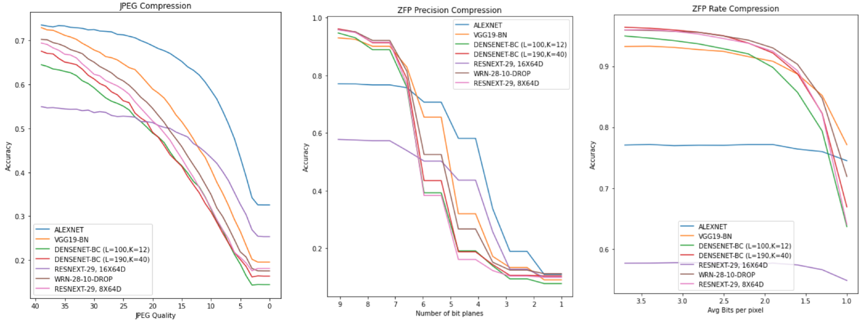
DATASET COMPRESSION : CORRECTNESS RAMIFICATIONS

Slide 45
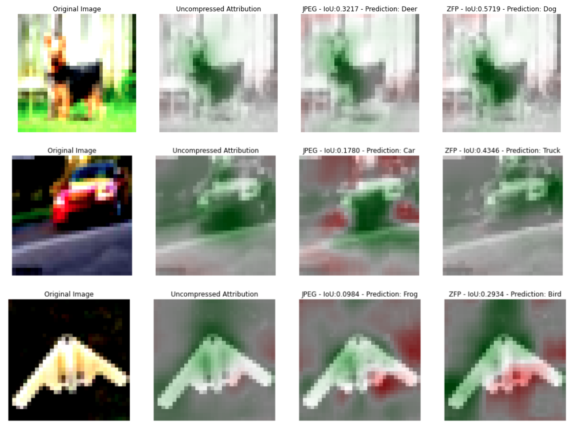
DATASET COMPRESSION : CORRECTNESS RAMIFICATIONS

Slide 46
DATASET COMPRESSION : CORRECTNESS RAMIFICATIONS
ZFP Compressed Datasets => Perform Error Analysis In Input Domain!

Slide 47
Summary: CORRECTNESS-PRESERVING COMPRESSION

